Slide 1
Breast Cancer Survival Prediction with Machine Learning
CHALAMALLA ESHWAR
chalamallan3@gmail.com

Slide 2
SYNOPSIS
Machine learning can be used to predict the survival rate of breast cancer patients. The process involves using a dataset of patient information, such as age, tumor_stage, Proteins and treatment history, to train a model. The model can then be used to predict the Patient_Status for new patients with similar characteristics.
There are various machine learning algorithms that can be used for breast cancer survival prediction, such as decision trees, random forests, and neural networks. The choice of algorithm will depend on the size and quality of the dataset, as well as the specific goals of the prediction task.
It's important to note that the results obtained from machine learning should be validated with clinical data to ensure that the prediction model is accurate and generalizable. Additionally, it is also important to consider ethical and legal implications when using machine learning for medical diagnosis and treatment.

Slide 3
OVERVIEW
Breast cancer is a type of cancer that develops in the cells of the breast. It is the most common cancer among women worldwide and the second most common cancer overall. The symptoms of breast cancer can include a lump or thickening in the breast or underarm area, changes in the size or shape of the breast, and changes in the skin on the breast or nipple, such as redness or dimpling.
The impact of breast cancer can be significant, both for the individual affected by the disease and for society as a whole. Breast cancer can have a major impact on a person's physical and emotional well-being, as well as their ability to work and participate in normal daily activities. The treatment of breast cancer can also be costly and can place a financial burden on patients and their families.
Early detection and diagnosis of breast cancer can improve the chances of survival. However, even with early detection, the survival rate for breast cancer varies depending on the stage of the cancer at the time of diagnosis and other patient characteristics

Slide 4
INTRODUCTION
Support Vector Classification (SVC) is a specific type of SVM that is used for classification tasks. In SVC, the goal is to find the hyperplane that separates the data into different classes in a high-dimensional feature space. Once this hyperplane is found, new data points can be easily classified by determining which side of the hyperplane they fall on. SVC is particularly useful when the data has a lot of features, or when the classes are not linearly separable, as the algorithm is able to find non-linear boundaries by using a technique called the "kernel trick". SVC is implemented in scikit-learn python library, which is a popular machine learning library for Python. It can be used in combination with different kernels, such as linear, polynomial, and radial basis function (RBF) to classify the data

Slide 5
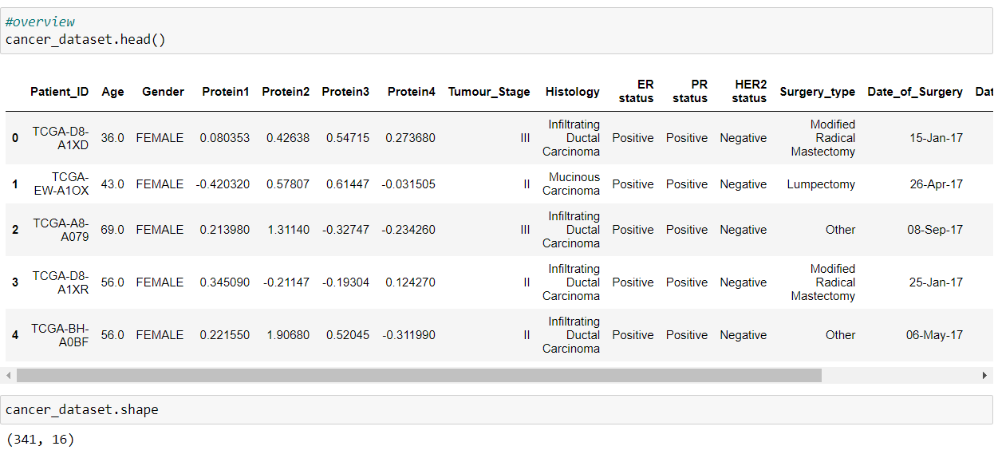
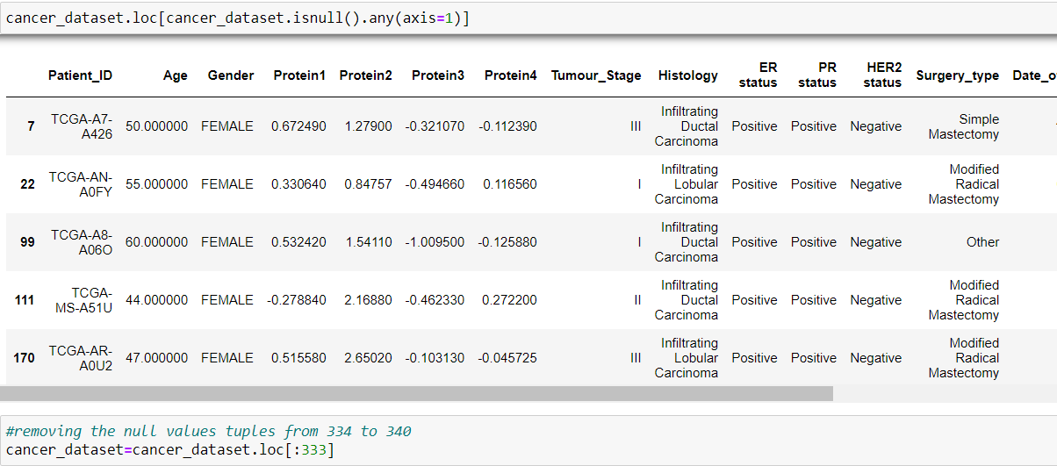
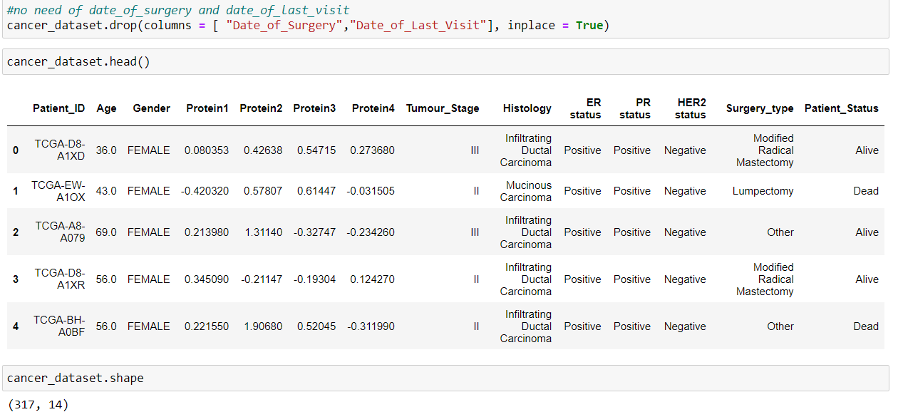
1.Preprocessing
Preprocessing is a crucial step in the machine learning pipeline that involves preparing the data for the model. It typically includes a combination of cleaning, transforming, and normalizing the data. The specific preprocessing steps will vary depending on the dataset and the model
Data Cleaning

Slide 6
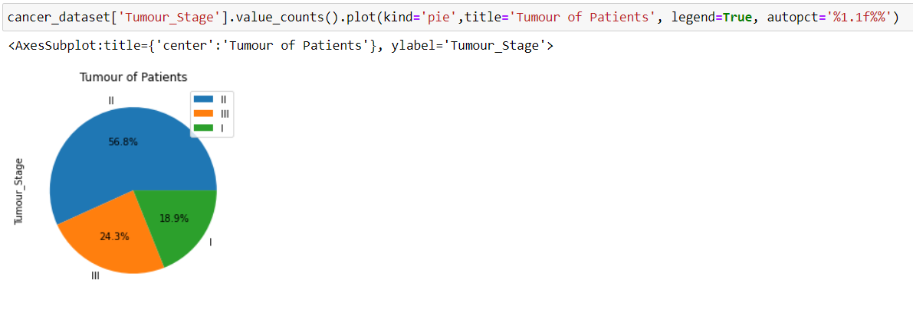
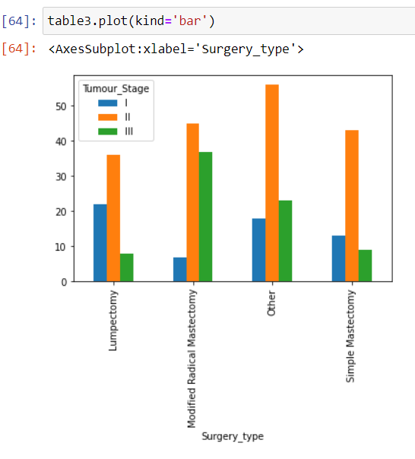
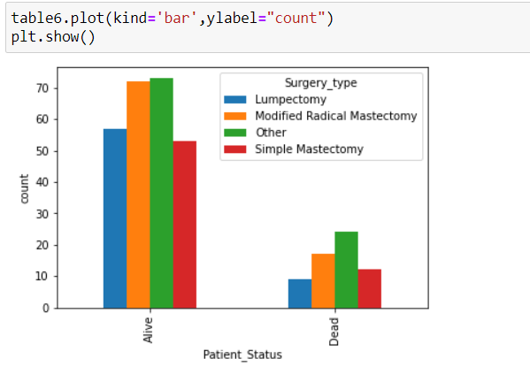
2.Data Visualization
Data visualization is the process of creating graphical representations of data in order to make it easier to understand and interpret. Data visualization can be used to explore and analyze data, to communicate insights, or to present results.

Slide 7
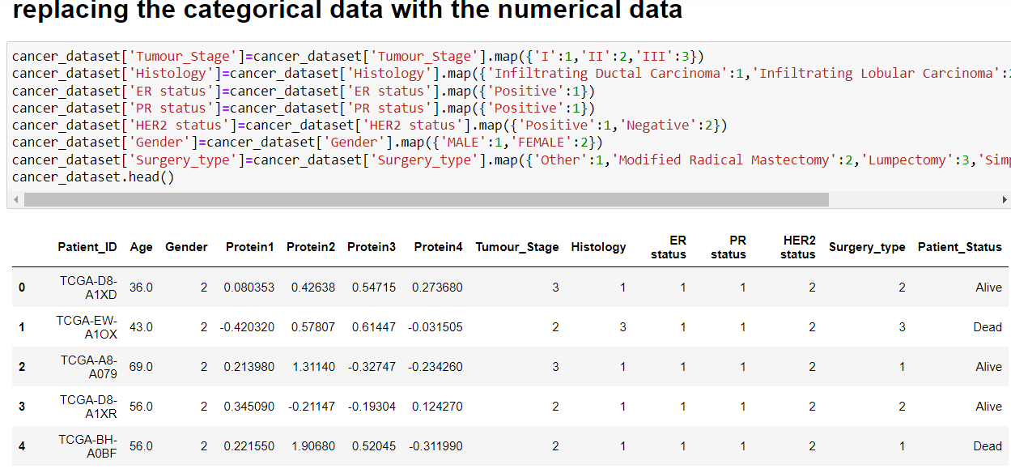
3.Data Transformation
his involves converting the data into a format that is more suitable for the model. This could include scaling the data, encoding categorical variables, or applying mathematical functions to the data

Slide 8
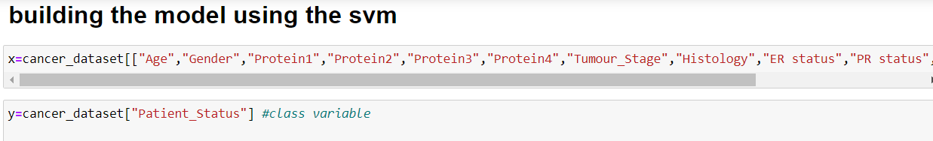
Training and Implementation Of SVM
We are using a dataset called Real Breast Cancer Data, which consists of attributes Patient_ID,Age,Gender,Protein1, Protein2, Protein3, Protein4,Tumour_Stage,Histology, ER status, PR status,HER2 status,Surgery_type,Date_of_Surgery,Date_of_Last_Visit,Patient_Status. We will be predicting the Patient_Status using SVM.
1. Read the data attributes in x variable except the class attribute and class attribute in y variable:

Slide 9
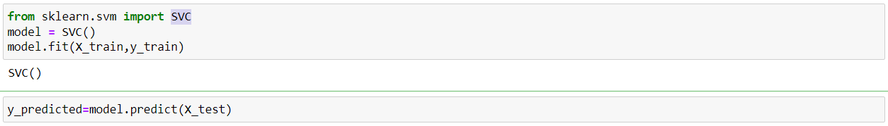
2.Import necessary packages and splitting data into testing and training with a test size of 0.2
3.create an instance of SVC python object and then fit the data and Generating predictions for our model

Slide 10
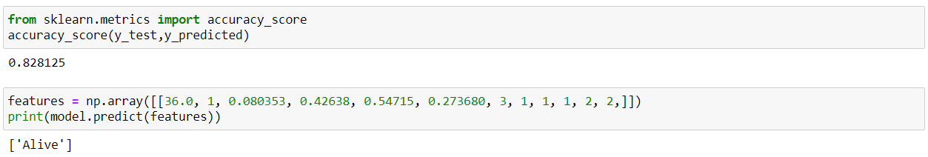
4.Finding the Accuracy of the model by comparing the predicted result and test result
And Now we will test the performance of the model by giving inputs to the model based on
the features they used to train it which means Passing the unknown values to the model which predicts the class label
.

Slide 11


